Slide 1
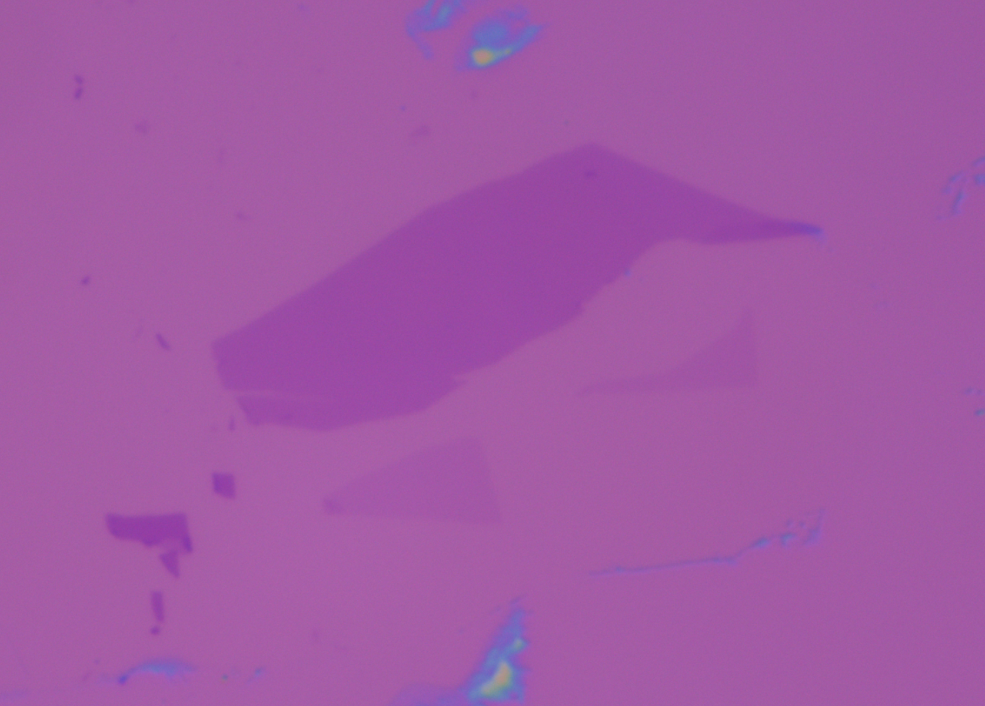
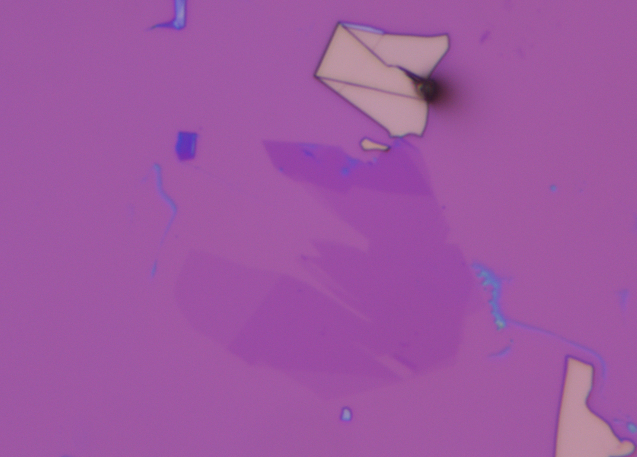
Few- layer
Monolayer
Monolayer
Few-layer

Slide 2
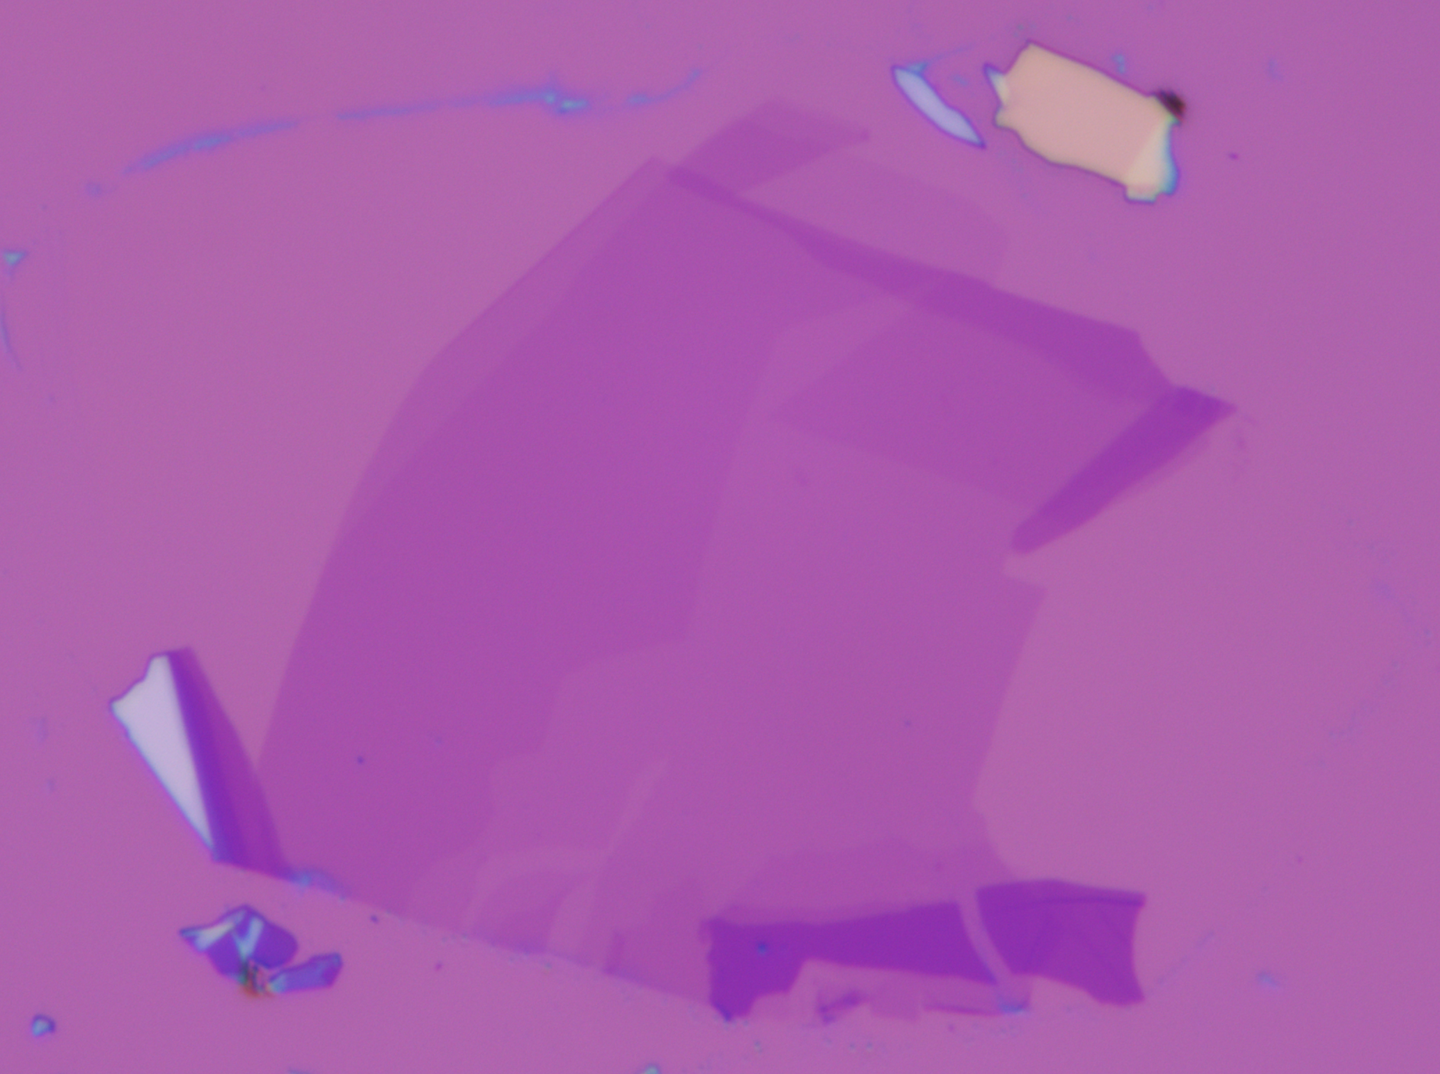
Monolayer
Few-layer
Bilayer

Slide 3
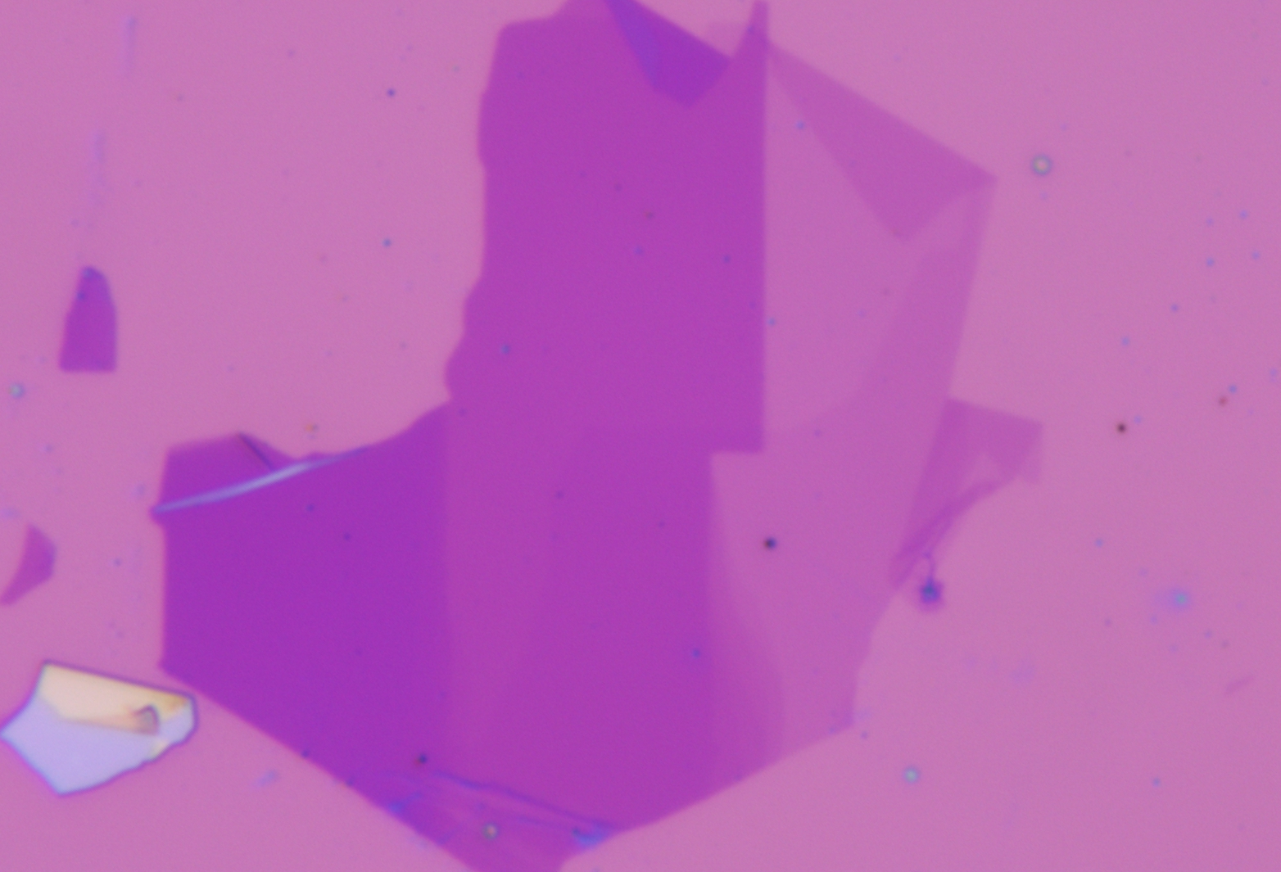
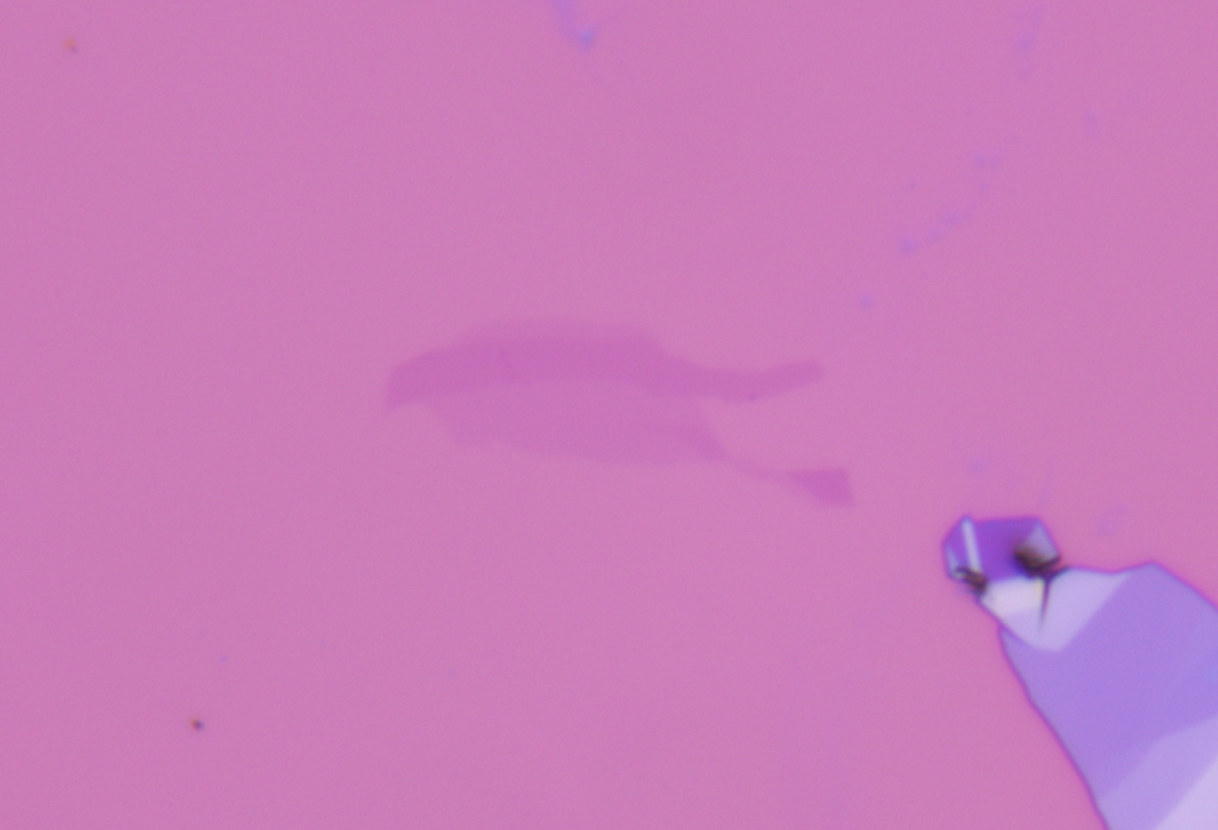
Monolayer
Few- layer
Bilayer
Monolayer
Bilayer

